Slide 1
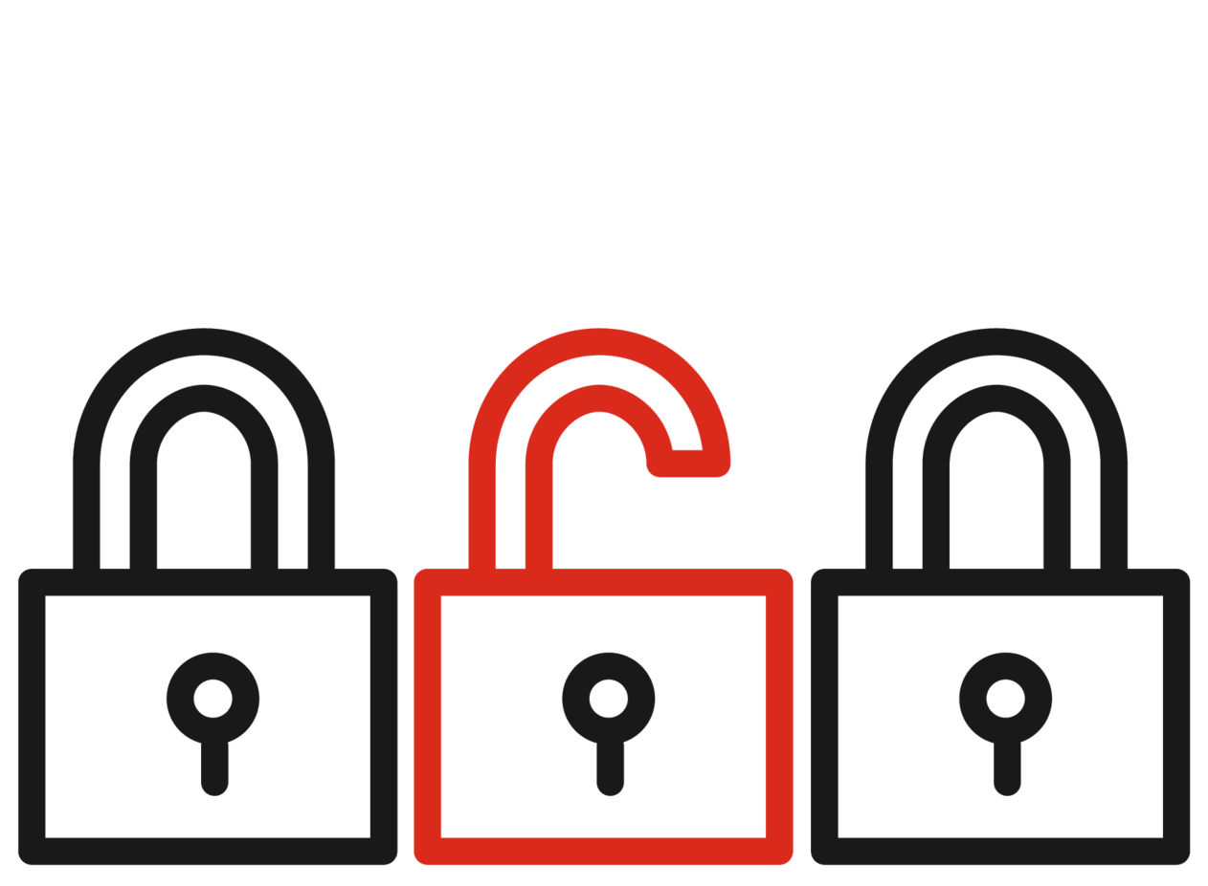
Vulnerability Management Main Misunderstandings
Oleksandr Kazymyrov 15.06.22

Slide 2




Agenda
Introduction
Common misunderstandings
Challenges
Summary

Slide 3
(Capability) maturity level
Processes are unpredictable, poorly controlled and reactive | Processes are defined and documented | Processes are standardized | Processes are monitored and controlled | Processes are continuously improved
Initial | Repeatable | Defined | Managed | Optimizing
Level 1 | Level 2 | Level 3 | Level 4 | Level 5

Slide 4
Types of risk treatment
High Probability
Transfer or Share
Avoid
Accept
Mitigate or Reduce
Low Impact
High Impact
Low Probability

Slide 5

Reports from our patch management solution show that vulnerabilities are patched
Frequency: Often

Slide 6

Vulnerability scanning is vulnerability management
Frequency: Often

Slide 7








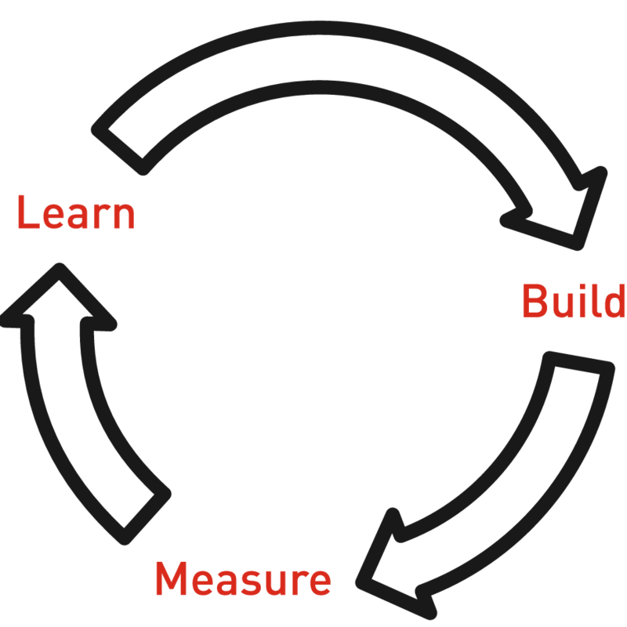

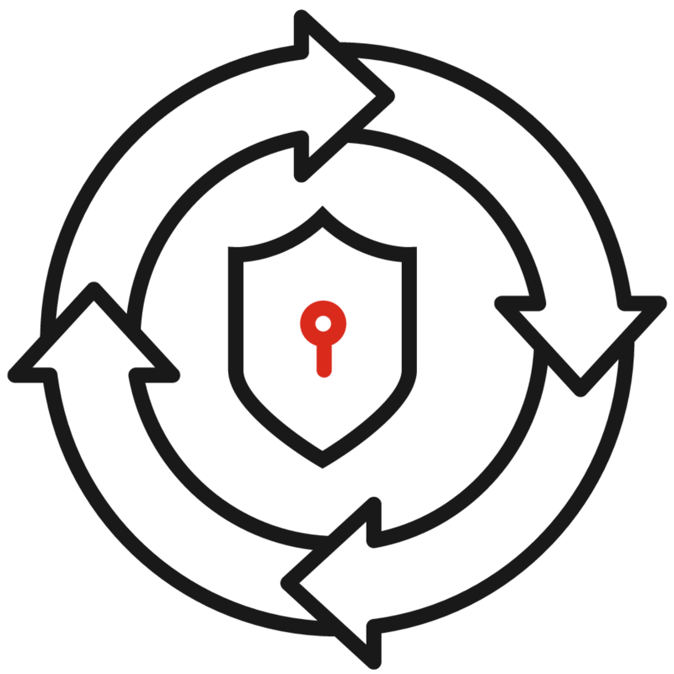



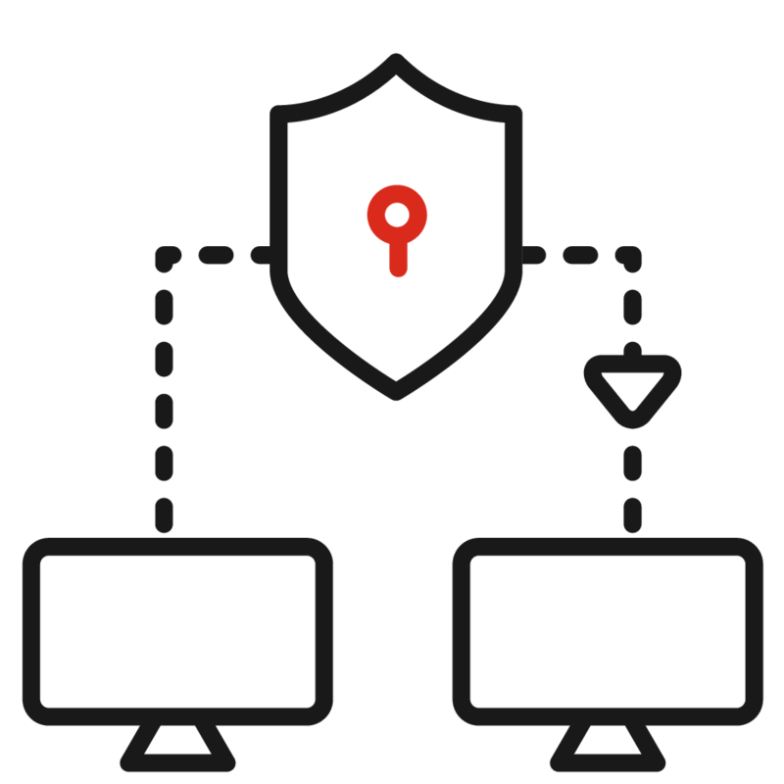
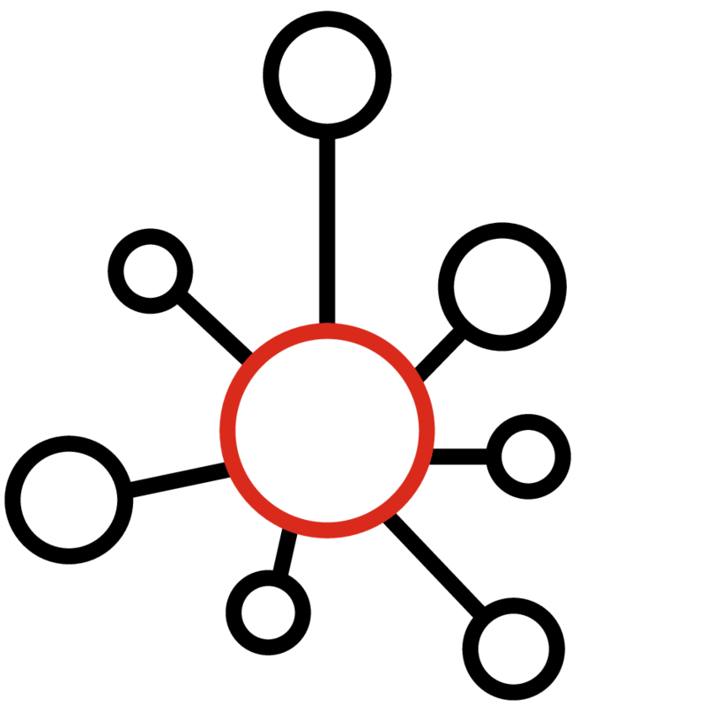





Technology
Process
People

Slide 8

Servers are not infrastructure
Clients/workstations
Network devices
Databases
Containers
IoT
Hypervisors
Web Applications
…

Slide 9

Vulnerability management is a one-time project
Frequency: Common

Slide 10
Network scanning vs agent-based scanning

Slide 11

Vulnerability scanning infrastructure
Support of vulnerability scanning infrastructure is a dedicated process

Slide 12
Extended vulnerability management
Integration with patch management system
Mobile device management
Cloud infrastructure audit
SCAP and OVAL Auditing

Slide 13
(Capability) maturity level
Processes are unpredictable, poorly controlled and reactive | Processes are defined and documented | Processes are standardized | Processes are monitored and controlled | Processes are continuously improved
Initial | Repeatable | Defined | Managed | Optimizing
Level 1 | Level 2 | Level 3 | Level 4 | Level 5
Vulnerability
Management
Patch
Management
Asset
Management
Configuration
Management

Slide 14
Vulnerability management relies on other processes
It does not make sense to establish vulnerability management if asset, patch, and configuration management have lower maturity levels

Slide 15






Takeout
Dependency
What is not VM?
Maintenance
Improve asset, patch, and configuration management before establishing vulnerability management
Vulnerability management is not a report from a patch management solution
Support of vulnerability scanning infrastructure is a dedicated process
Expansion
Resources
Existing tools
Vulnerability scanners are more than vulnerability collectors
Plan resources far in advance
Most EDR has vulnerability overview

Slide 16
Vulnerability management policy
External
[untrusted networks (e.g., the Internet or service providers)]
Motto: zero tolerance
Exploitable vulnerabilities are incidents with P1
Vulnerabilities of serenity medium and above must be eliminated (risk is avoided)
Active protection controls have informational status
Continuous asset reconnaissance
Vulnerability scanning from independent environments with minimal period between scans
Internal
[can impose (security) requirements]
Motto: zero trust
Exploitable vulnerabilities must be mitigated fist (risk is avoided)
Other legacy best practices
Active protection controls must be implemented when possible
Hybrid vulnerability scanning
Accepted risks must have a re-evaluate date

